Slide 1

Financial assistance

Slide 2
Presented by
Shubham pandey - AP21110010940
Anulikhitha Immedisetty – AP21110010963
Nandini Gogineni – AP21110010912
Arshad Shaik – AP21110010926

Slide 3

Agenda
INTRODUCTION
AIM OF THE PROJECT
ABSTRACT
PROJECT IMPLEMENTATION PROCESS
Technology Used
System Requirements
Features
METHODOLOGY
SOURCE CODE
OUTPUT
CONCLUSION
FUTURE WORKS
REFERENCES

Slide 4

INTRODUCTION
In today’s competitive world everybody is looking for ways to invest in the various stock markets. When they want to make investments in the stocks the first thing that comes upon individual’s mind is, if they can secure shares in the particular stocks or sell the stocks and checking their worth or gains.
FINANCIAL ASSISTANCE refers share purchase, assistance given by a company for the purchase of its shares or those of its holding companies. The purpose of this project is to predict stock price of its holding companies using some of the header files Matplotlib, Mpl finance, Pandas, Pickle, Data time and the numerous types of functions. For this purpose, we have proposed a method that will analyse the portfolio , adding shares, selling shares, portfolio worth & gains, charts of the portfolio, etc.

Slide 5

The aim of this project is to design a portfolio using some of the libraries like matplotlotlib, pandas and so on. The main objective of this system is to provide details of the stocks and prices of its holding companies to the user/depositor. This software offers a wide range of standard modules providing a highly efficient stock market for all types of investors. It also offers the users to check their worth, gains , adding shares or selling shares. At last, but not least it also shows the users graph of the portfolio by comparing dates, respectively.
AIM OF THE PROJECT

Slide 6
Abstract
It is one of the leading platforms for all phases of people as they provide comprehensive knowledge about the portfolio , adding shares, selling shares, portfolio worth & gains, charts of the portfolio, etc. Financial Assistance is not demanding task since we develop more modules for execution.
In this project we attempt to implement some of the functions like Matplotlib, Mplfinance, Pandas, Pickle, Datatime. This platform tells us how we can predict stock prices of its holding companies. The objective is to predict the stock prices in order to make more informed and accurate investment decisions.
Coming to the features of this Financial Assistance using Python. At first, the user has to login by using ID and PASSWORD. Then the user will check shares in the portfolio and succeeding functions in the portfolio.
Financial Assistance is a desktop application software system where the supervision of entire portfolio is automated.
This platform is a user friendly and extremely helpful to numerous individuals . We have created this project based on the understanding from Python Programming until….

Slide 7
project implementation process
TECHNOLOGY OWNED:
Language : Python
IDLE : Python IDLE (Integrated Development and Learning Environment)
Operating System : Mac OS 12.2 Windows 11 Linux It will run in any operating system
SYSTEM REQUIREMENTS:
Processors : In Mac IOS – M1 chip.
In Windows – Intel i5 processor
Disk space : In Mac IOS – 8GB & 8GB+
In Windows – 3 to 4 GB
Python Version : Python 3.9.8
FEATURES:
Financial Assistance inserts the subsequent features as follows:
a)Add shares in the portfolio
b)To save shares in the portfolio
c)To sell shares in the portfolio
d)To show the portfolio
e)To show portfolio worth
f)To show portfolio gains
g)End

Slide 8
methodology
Approach of functions are owned in the leading platform. Below are the functions created as follows to work on the portfolio.
1)save_credentials () – Function for the user to save the credentials which are entered by using Id and password.
2)change_credentials () – Function for the user to change the credentials if the password did not match to the user’s Id.
3)change_id () – Function for the user to change ID if the user entered did not match and PASSWORD if the user entered did not match.
4)process_portfolio () – Function to display the leading platform main screen i.e., the portfolio of the project which we can select the demanded option to execute.
5)log_in () – Function for the user to login the account by entering his/her Id and Password.
6)save_portfolio () – Function for the user to save the shares in the portfolio.
7)add_portfolio () – Function for the user to add the shares in the existing portfolio.
8)remove_portfolio () – Function for the user remove the shares by checking in the existing portfolio.
9)show_portfolio () – Function for the user to show the shares has in the existing portfolio.
10)portfolio_worth () – Function for the user to show the worth like how much shares have equivalent in value
11)portfolio_gains () – Function for the user to show how much stocks have gained checking the portfolio data like starting date and today date.
12)plot_char () – Function for the user to plot the chart by using the co-ordinates in the existing portfolio by using matplotlib.pyplot function.

Slide 9

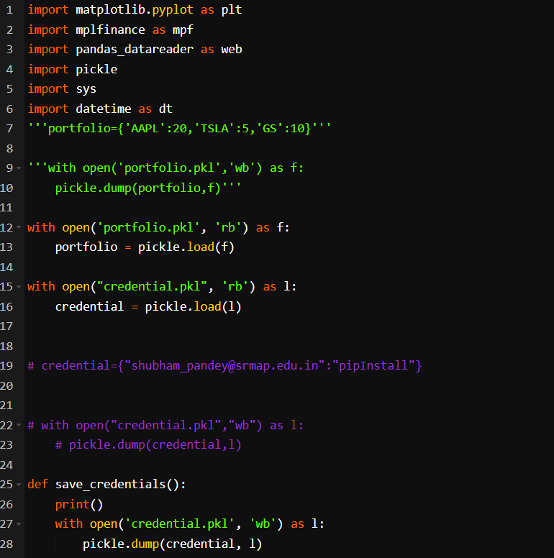
SOURCE CODE

Slide 10
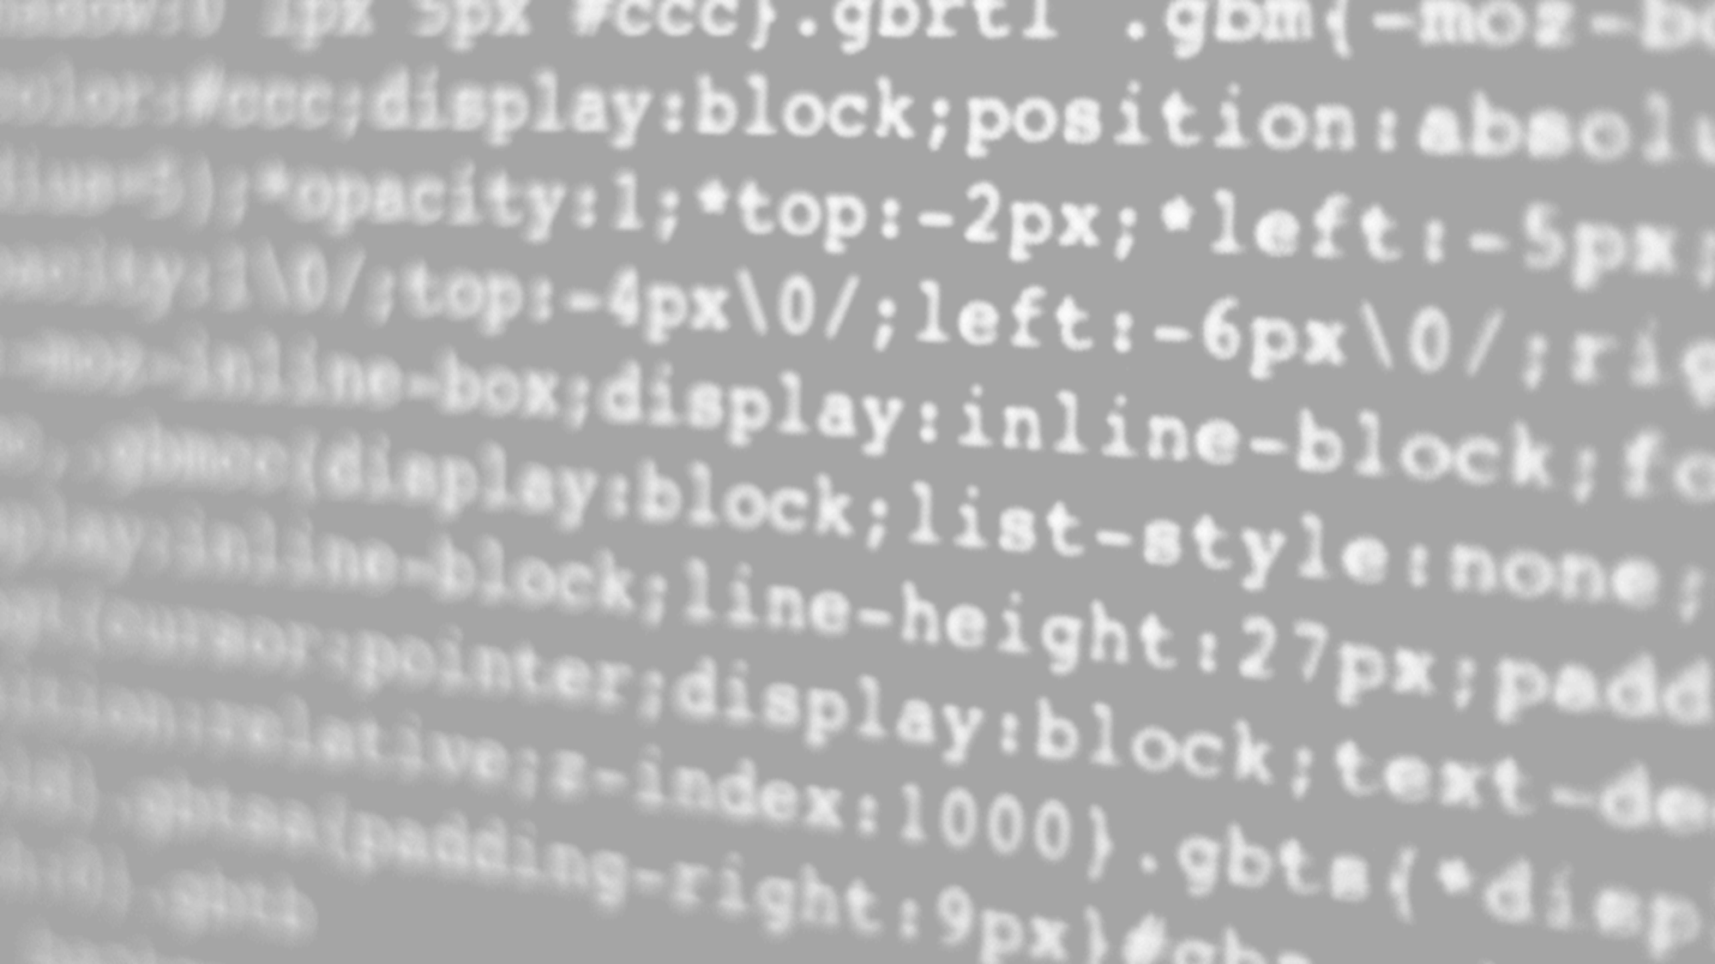
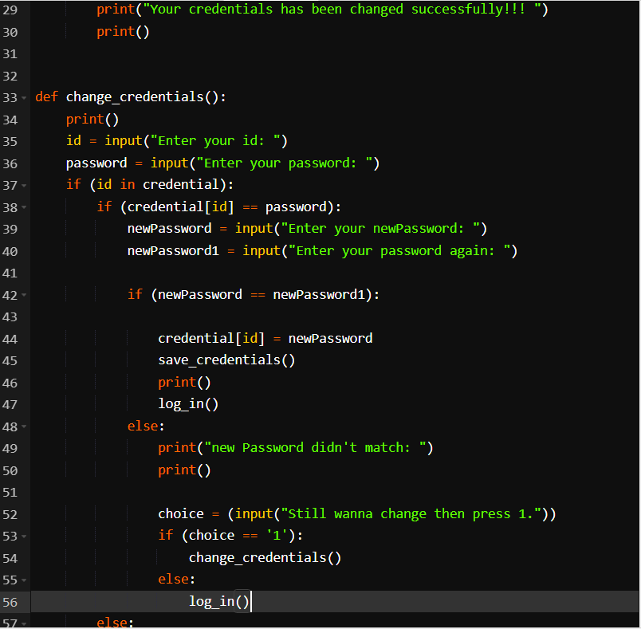

Slide 11

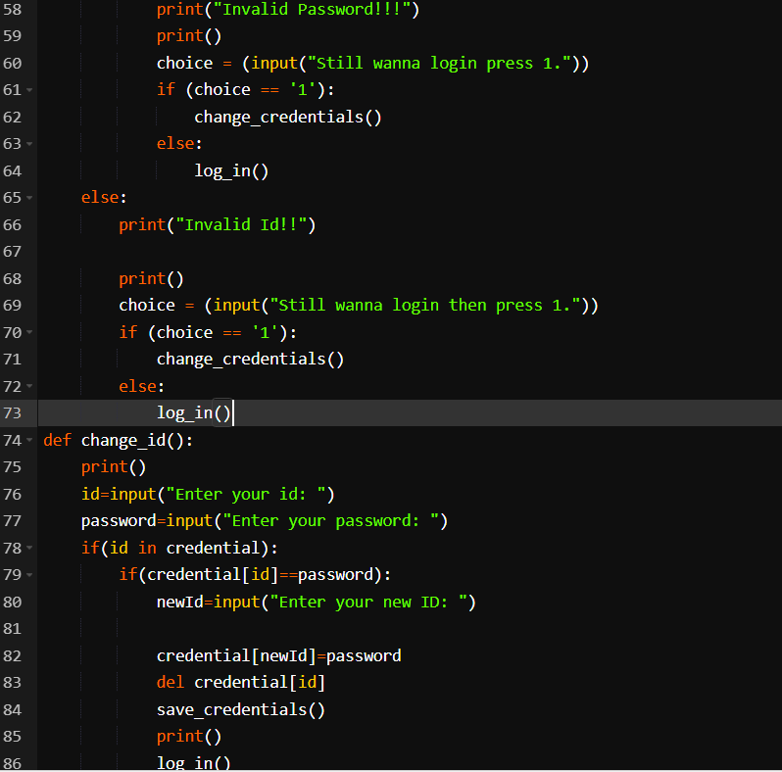

Slide 12
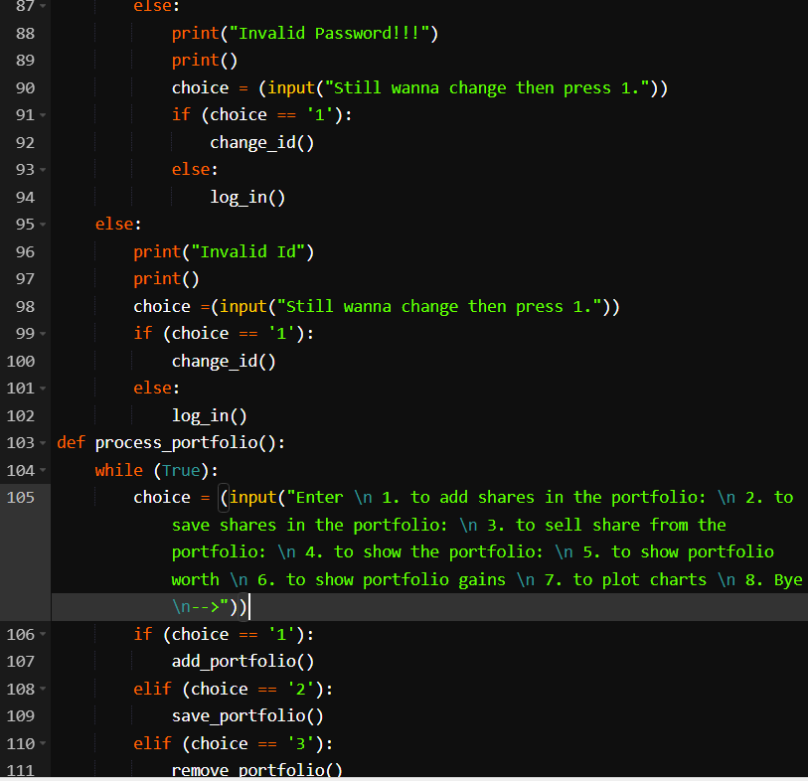

Slide 13

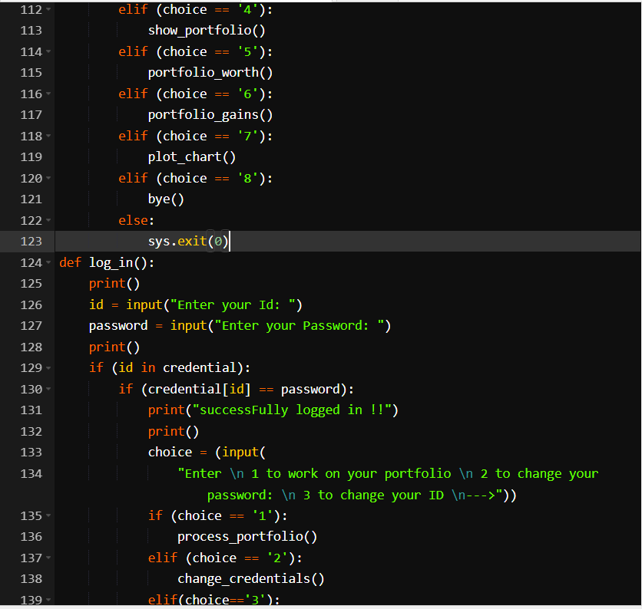

Slide 14

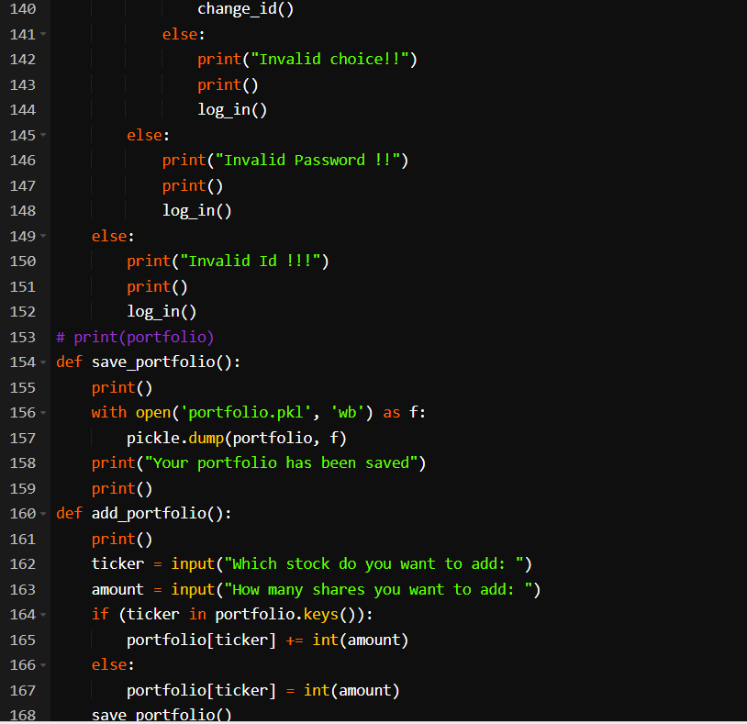

Slide 15
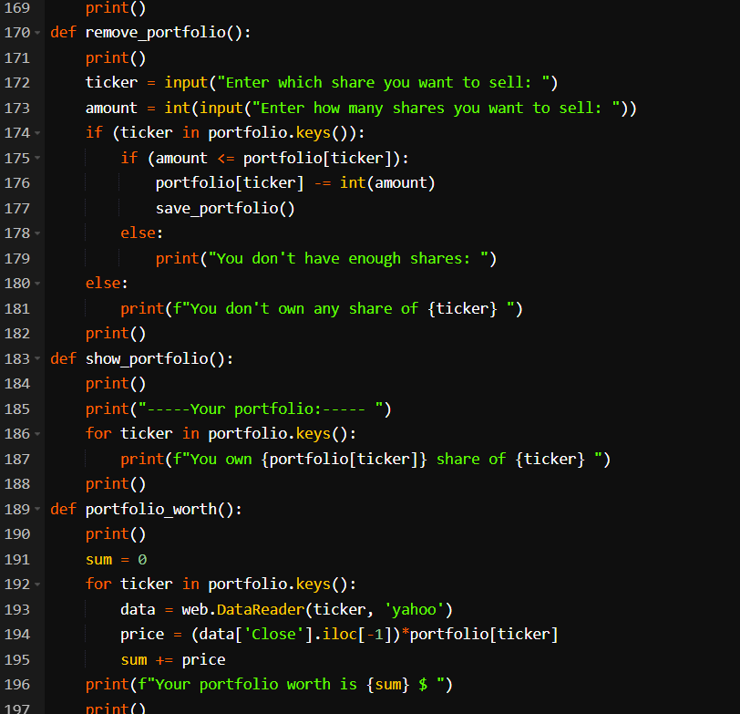

Slide 16
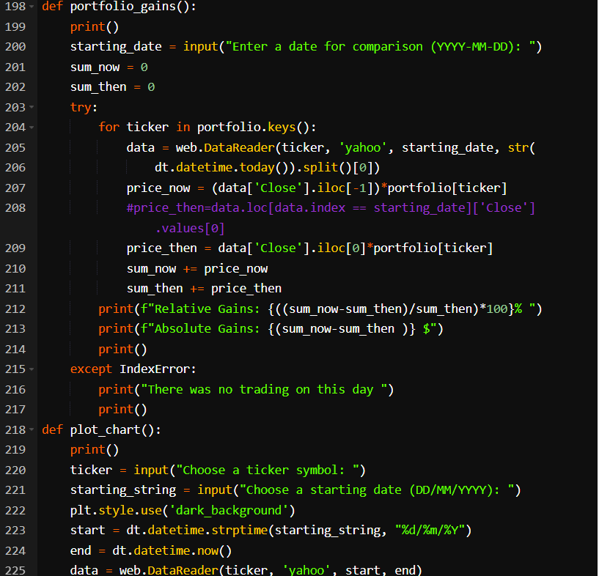

Slide 17
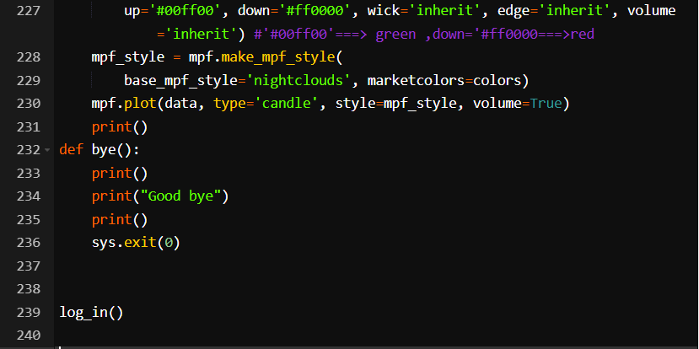

Slide 18

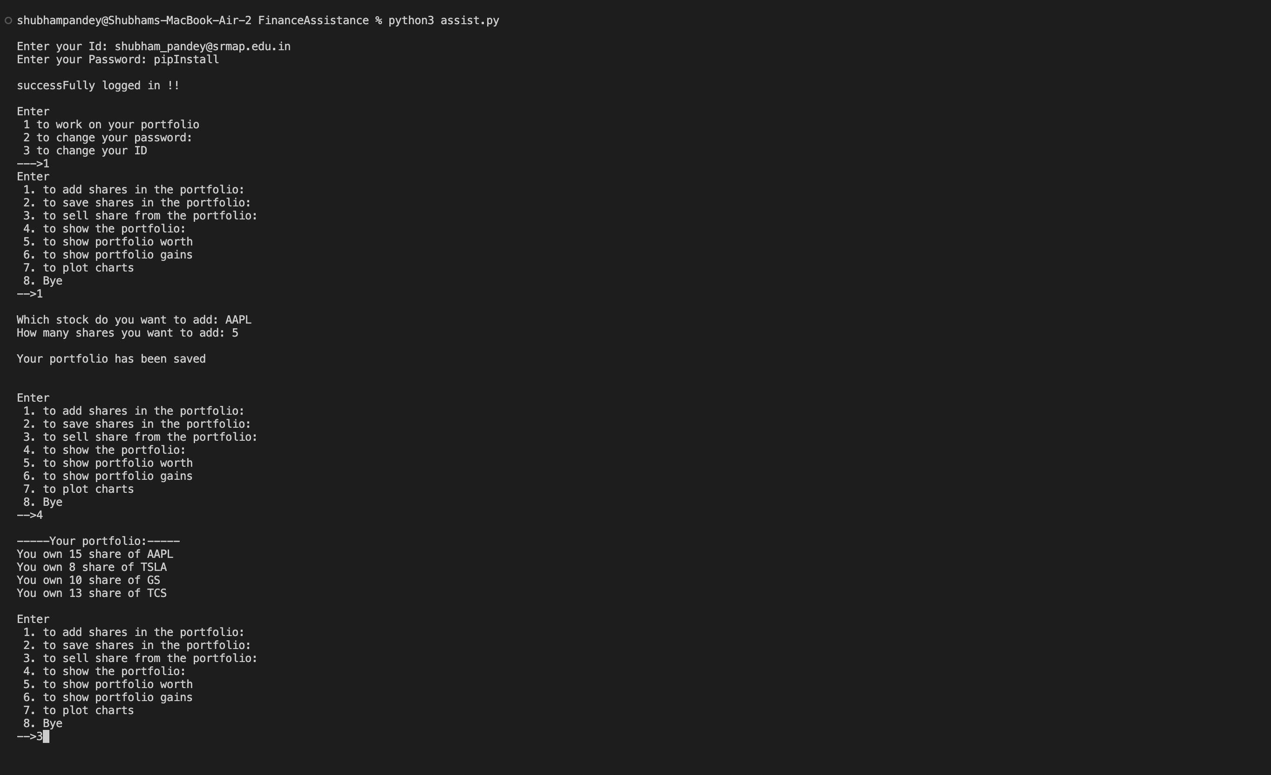
OUTPUT

Slide 19
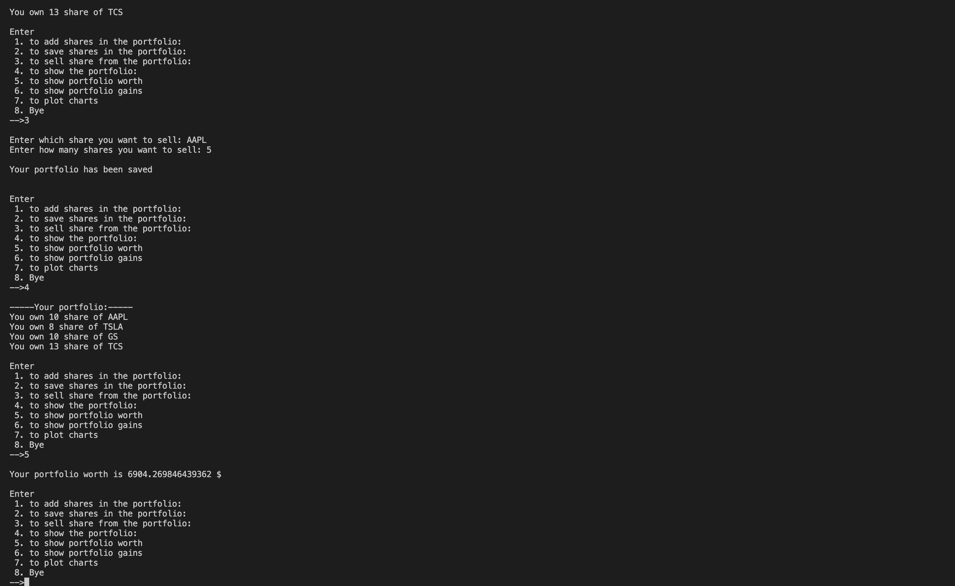

Slide 20
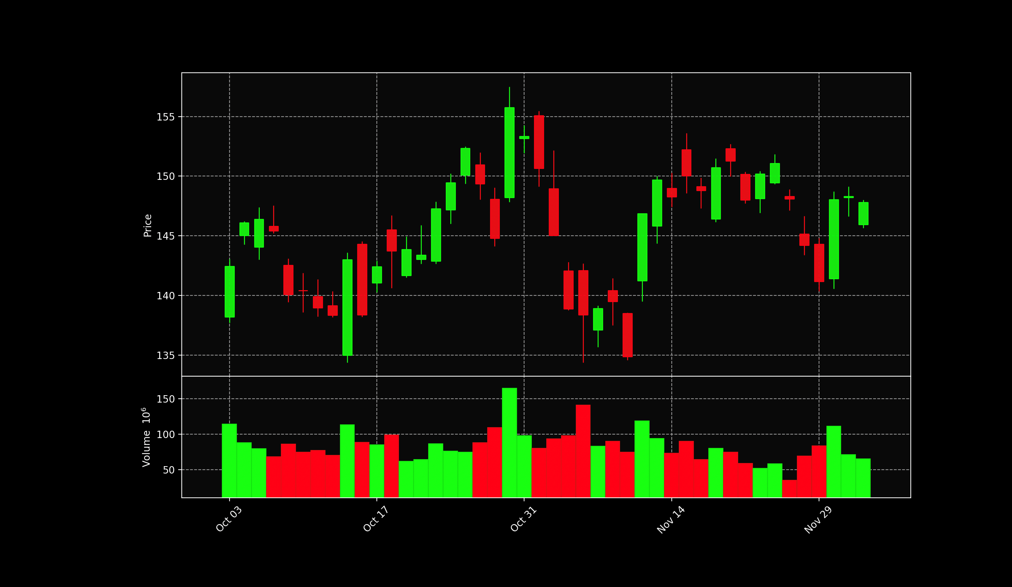

Slide 21
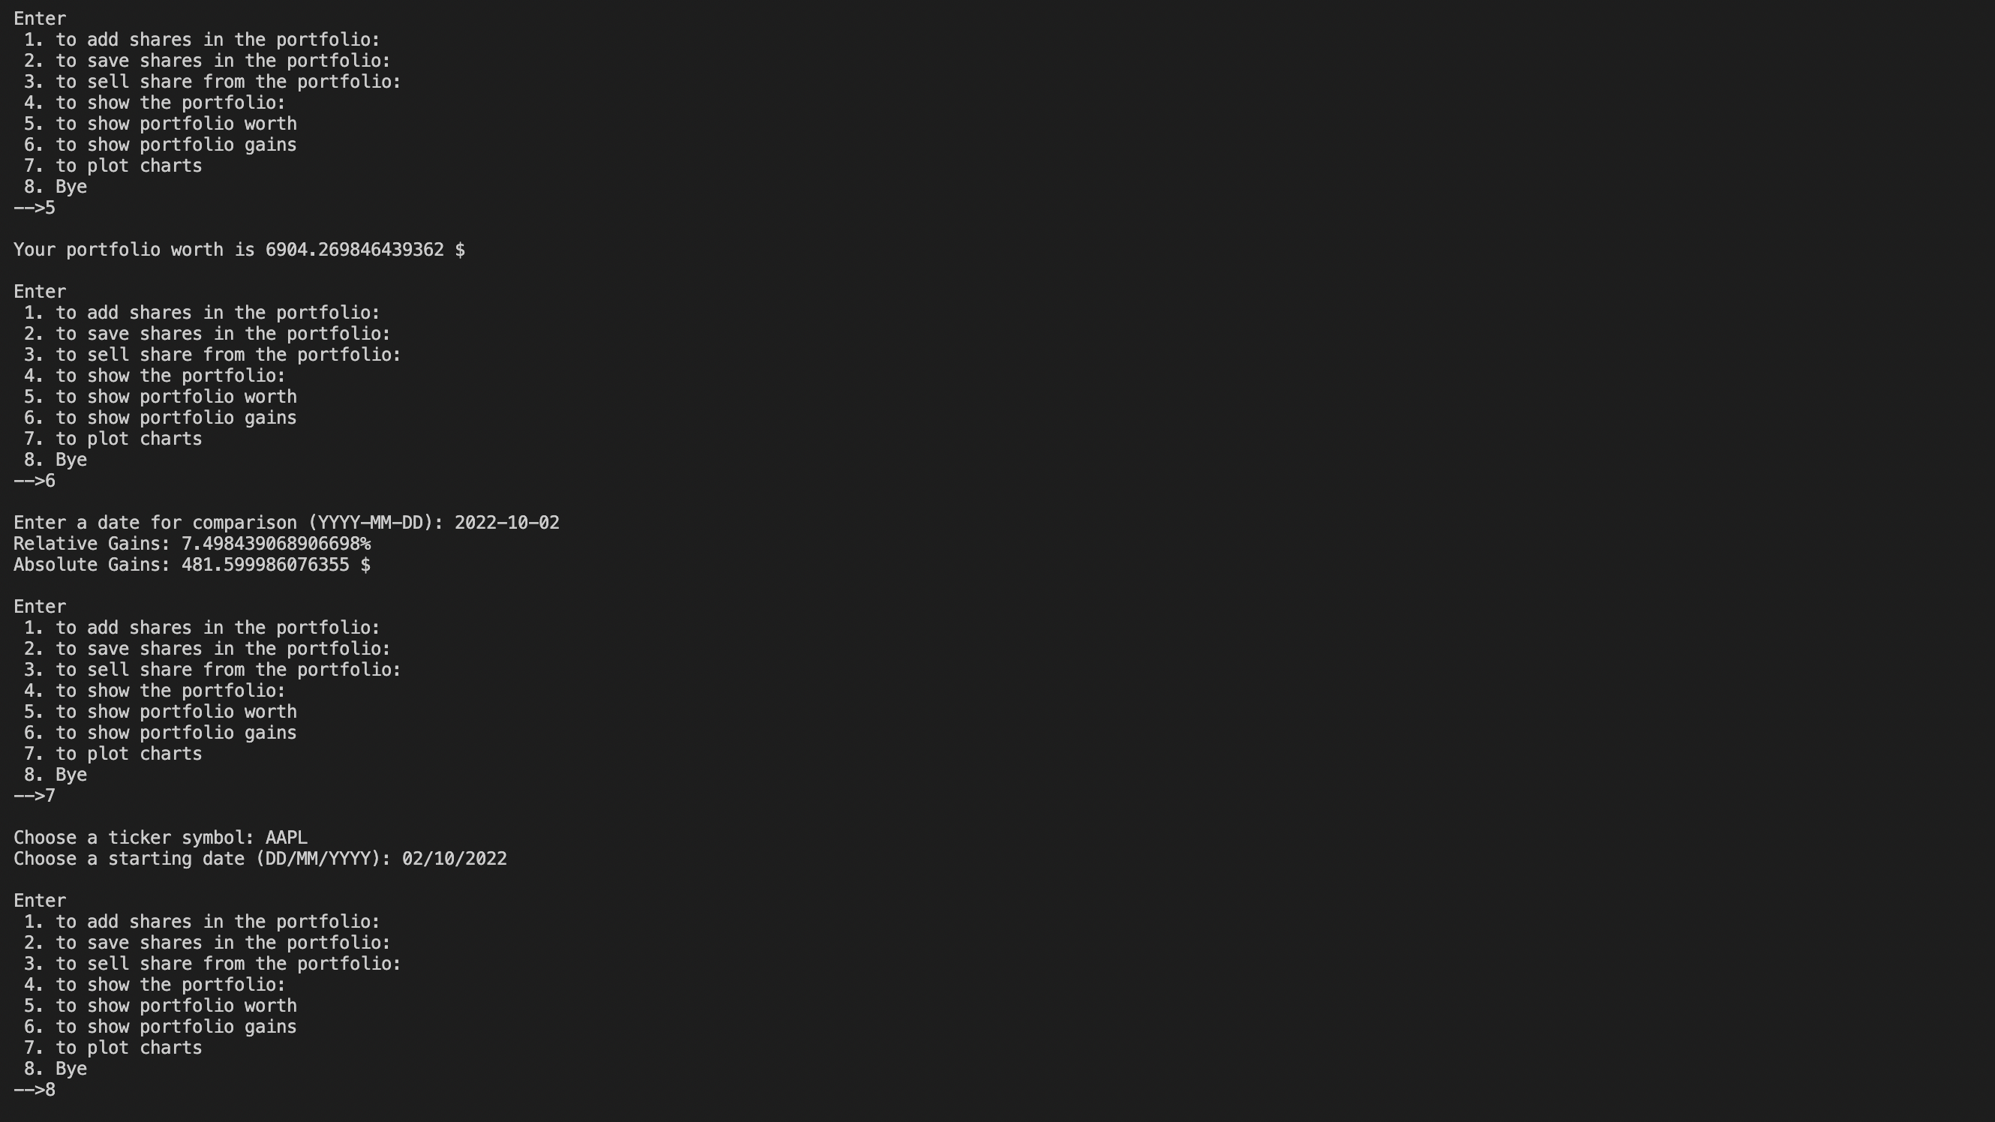

Slide 22
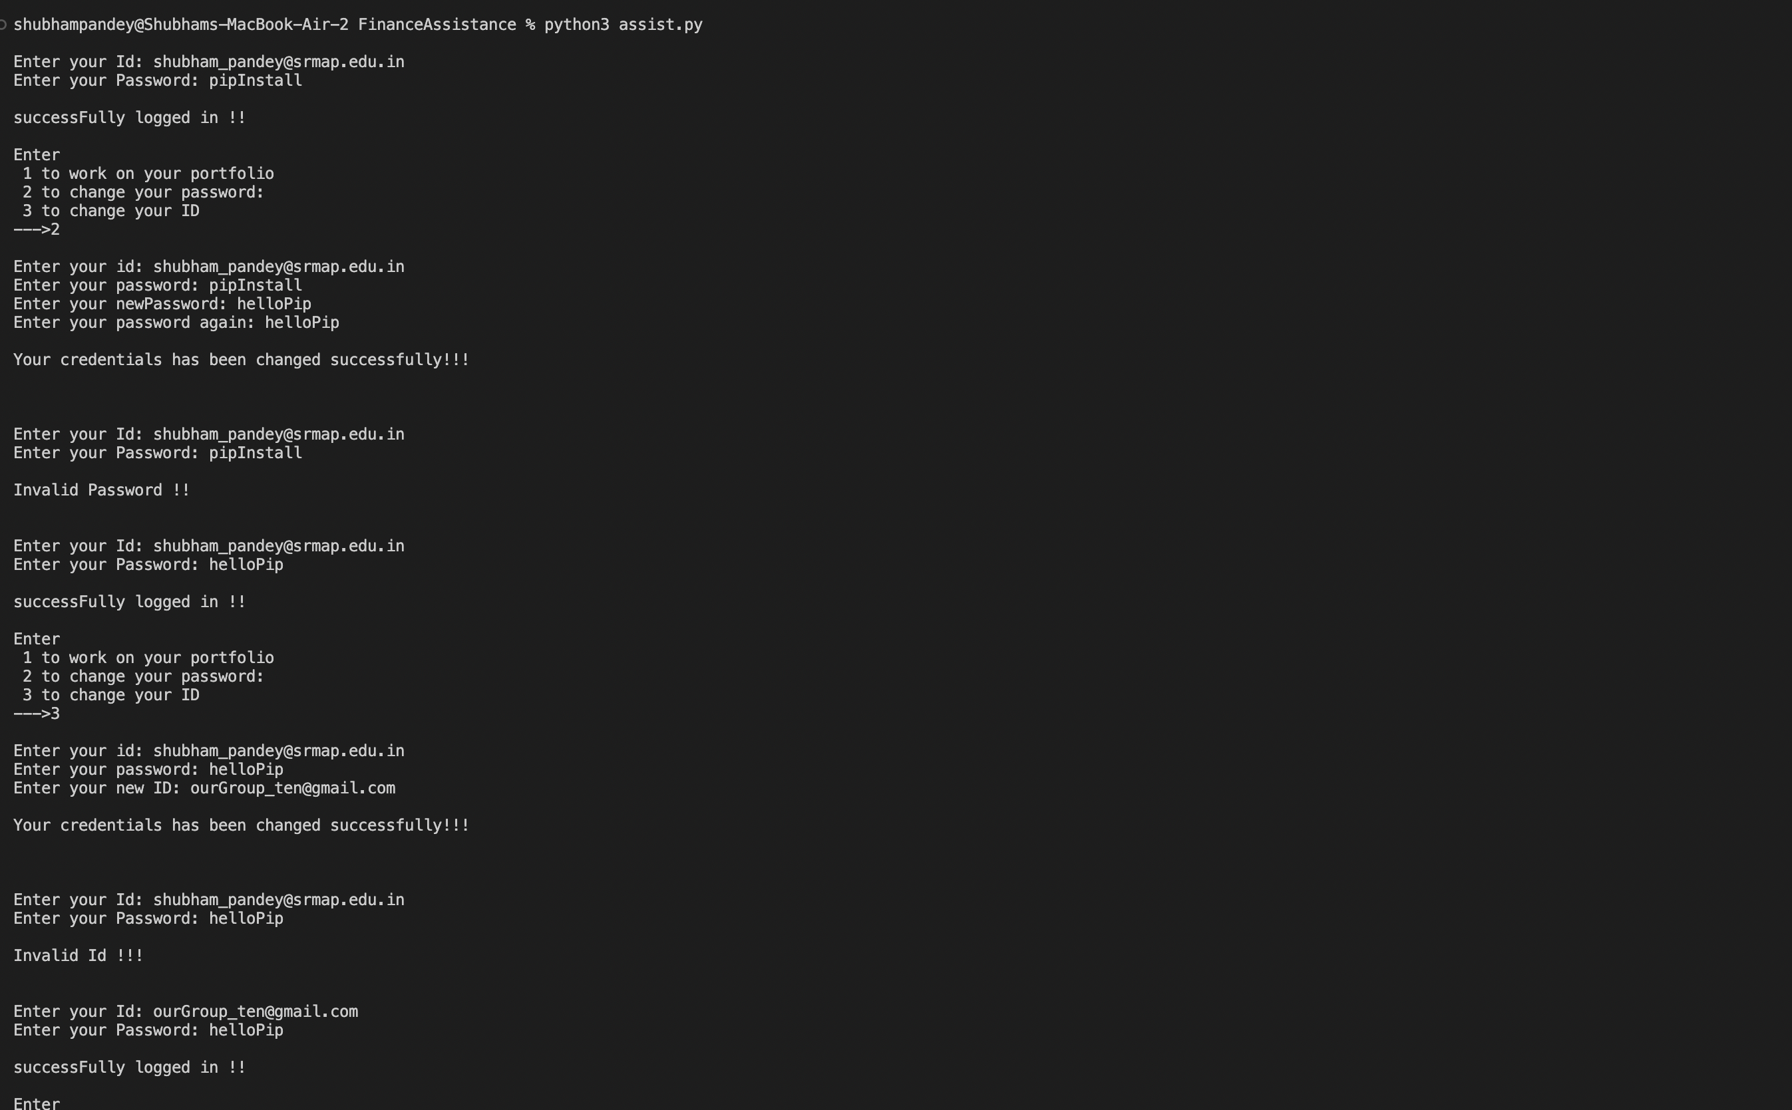

Slide 23

CONCLUSION
By making this project we got to learn about modules like matplotlib, pandas, pickle,sys, datatime etc.,
This project will assist the people who are into stock market.
It will help them to know about their portfolio and study candlestick chart.
Studying candlestick charts will help them to predict whether the market is bullish or bearish.
Hence, this project also helps in analysis of stock.
We can compare then and now prices of stock also we can plot the chart on prices of stock with volume of shares that have been traded in a particular day

Slide 24

future works
We can add many features to our project not only about stocks but also about all other investments that an individual has made.
By adding extra features, we can track our investment area and work on it wisely.
We can create our own datebase also we can add security protocol to our project.
We can add GUI (Graphical User Interface) to our project which gathers input from users, and then displays the prediction results.
There are many features that we will add to our project in future

Slide 25
References
Financial Assistance project can be referred from the below URL
URL: https://youtu.be/Y47kjQvffPo

Slide 26
THANK YOU

